Slide 1

Does Hotspot Policing
SECURITY & CRIME SCIENCE
Work?

Slide 2
Effects of patrol outside hotspots

Slide 3
“Patrol is considered the backbone of police work”
“The assumption underlying such deployment has been that the presence or potential presence of officers patrolling the streets in marked police cars deters people from committing crime.”
Source: National Police Foundation. n.d. The Kansas City Preventive Patrol Experiment.

Slide 4
How effective do you think general police patrol is at reducing crime?

Slide 5
What other effects do you think general police patrol might have?

Slide 6
Kansas City Preventative Patrol Experiment
Patrol beats divided into three groups for one year
“proactive”
2–3 times normal level of patrol
“reactive”
emergency response only
“control”
normal level of patrol
Source: National Police Foundation. n.d. The Kansas City Preventive Patrol Experiment.

Slide 7
Kansas City Preventative Patrol Experiment
no change in recorded crime
no change in fear of crime
no change in perceptions of police
offenders didn’t notice the change …
… and neither did anyone else
Source: National Police Foundation. n.d. The Kansas City Preventive Patrol Experiment.

Slide 8

“It is not surprising that less than 1% of offenses end with the offender caught in the act by police on patrol.
“Doubling the number of police in a US metropolis is like doubling a drop in the bucket.”
Source: M Felson. Crime and Everyday Life. 3rd Ed. Thousand Oaks: Sage. p. 5

Slide 9
There can never be enough police to patrol everywhere
7,200 Met Police patrol officers
7,200 ÷ 5ish ≈ 1,400 patrol officers on duty now
205,400 ÷ 1,400 ≈ 140 street segments per patrol officer
Source: Home Office. 2018. Police workforce, England and Wales: 31 March 2018.
Notes:
This assumes no calls are being answered, prisoners handled etc.
MPS responds to about 1,200 immediate-grade calls per day
Source for calls data: https://www.met.police.uk/SysSiteAssets/foi-media/metropolitan-police/disclosure_2017/august_2017/information-rights-unit---volume-of-999-calls-in-london-boroughs-on-any-given-day-in-the-first-six-months-of-2017

Slide 10
Effects of hotspot policing on crime

Slide 11
Methods
Randomised controlled trials
Quasi-experimental designs
Source: A Braga, A Papachristos & D Hureau. 2014. The Effects of Hot Spots Policing on Crime: An Updated Systematic Review and Meta-Analysis. Justice Quarterly 31(4):633–663.
Notes:
Explain RCTs
Quasi-experimental designs don’t use random allocation
Quasi-experiments often find larger effects than RCTs

Slide 12
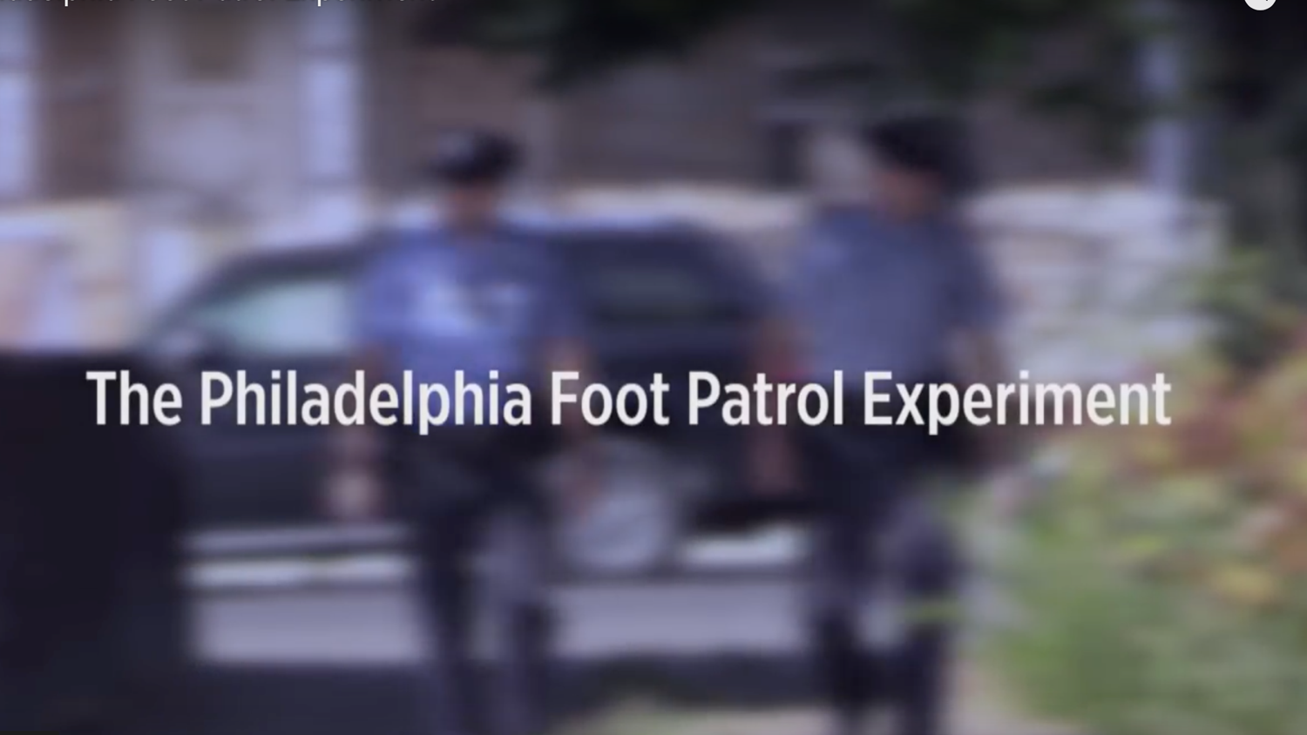

Slide 13
What method did the study use?
What effect did the study find that hotspot policing had on crime?
What other effects (if any) did the study find that hotspot policing had?
What are the limitations of the study data, methods and findings?

Slide 14
Source: A Braga, A Papachristos & D Hureau. 2014. The Effects of Hot Spots Policing on Crime: An Updated Systematic Review and Meta-Analysis. Justice Quarterly 31(4):633–663.
Notes:
Explain forest plot
Overall, significant decrease in crime
13 studies found significant decrease in crime
No studies found significant increase in crime

Slide 15
Does the crime just move around the corner?

Slide 16
Displacement
“Displacement is the relocation of a crime from one place, time, target, offense, tactic, or offender to another as a result of some crime-prevention initiative.”
surrounding area
(no intervention)
intervention area
Source: R Guerette & K Bowers. 2009. Assessing the extend of crime displacement and diffusion of benefits: a review of situational crime prevention evaluations. Criminology 47(4):1331–1368.

Slide 17
Diffusion of benefit
“Diffusion occurs when reductions of crime … are achieved in areas that are close to crime-prevention interventions, even though those areas were not actually targeted by the intervention itself”
surrounding area
(no intervention)
intervention area
Source: R Guerette & K Bowers. 2009. Assessing the extend of crime displacement and diffusion of benefits: a review of situational crime prevention evaluations. Criminology 47(4):1331–1368.

Slide 18
worst
Malign displacement
Benign displacement
No displacement or diffusion
Some diffusion
Substantial diffusion
displacement erodes intervention effect
displacement outweighs intervention effect
no effect on intervention
diffusion amplifies intervention effect
diffusion surpasses intervention effect
best
Source: R Guerette & K Bowers. 2009. Assessing the extend of crime displacement and diffusion of benefits: a review of situational crime prevention evaluations. Criminology 47(4):1331–1368.

Slide 19
Source: A Braga, A Papachristos & D Hureau. 2014. The Effects of Hot Spots Policing on Crime: An Updated Systematic Review and Meta-Analysis. Justice Quarterly 31(4):633–663.
Notes:
Overall, significant diffusion of benefits
One study found significant displacement
Seven studies found significant diffusion of benefits

Slide 20
Effects of hotspot policing on police legitimacy

Slide 21
Legitimacy helps effective policing
“When the police … communicate with people fairly, respectfully, neutrally, trustworthily and allow for people to voice their concerns, the public … are more likely to voluntarily comply with laws and cooperate with police directives”
Source: S Bennett, M Newman & M Sydes. 2017. Mobile police community office: a vehicle for reducing crime, crime harm and enhancing police legitimacy? Journal of Experimental Criminology 13(3):417–428.

Slide 22
But does hotspot policing damage legitimacy?
“aggressive or intrusive policing tactics, while effective as short-term crime fighting strategies, may have long-term implications for police legitimacy”
Source: T Kochel. 2010. Constructing Hot Spots Policing: Unexamined Consequences for Disadvantaged Populations and for Police Legitimacy. Criminal Justice Policy Review 22(3):350–374.
Notes:
Non-empirical study

Slide 23
But does hotspot policing damage legitimacy? Possibly
“[the] study shows short-term negative effects on procedural justice and potentially on police legitimacy among [dedicated patrol] hot spot residents …
“[but] the effects are small, and … they are not sustained in the long term once treatment concludes.”
Source: T Kochel & D Weisburd. 2017. Assessing community consequences of implementing hot spots policing in residential areas: findings from a randomized field trial. Journal of Experimental Criminology 13(2):143–170.
Notes:
Study in St Louis, MO
Hotspots randomly allocated to additional patrol or not
Survey of residents before, during and six-months after

Slide 24
But does hotspot policing damage legitimacy? Possibly not
“we compared residents’ perceptions of procedural justice and police effectiveness as well as their trust in the police and fear of crime … we found no statistically significant difference between residents who lived in the control hot spots and those in the experimental condition”
Source: S Bennett, M Newman & M Sydes. 2017. Mobile police community office: a vehicle for reducing crime, crime harm and enhancing police legitimacy? Journal of Experimental Criminology 13(3):417–428.
Notes:
Study in Queensland
Hotspots randomly allocated to get a mobile police station visit or not
No difference in survey results between groups, but no change in crime either

Slide 25
What happens when hotspot policing ends?

Slide 26
If hotspot policing works by deterrence, what happens when the deterrent goes away?
“Three months after the experiment, the statistically significant differences in violent crime between the experimental and control areas could no longer be detected.”
Source: E Sorg, C Haberman, J Ratcliffe & E Groff. 2013. Foot patrol in violent crime hot spots: the longitudinal impact of deterrence and posttreatment effects of displacement. Criminology 51(1):65–101.

Slide 27
What don’t we know about hotspot policing?

Slide 28
What don’t we know about hotspot policing?
Does hotspot policing work outside big cities?
What are the long-term effects?
Is hotspot policing good value?

Slide 29
Does Hotspot Policing
SECURITY & CRIME SCIENCE
Work?

